Slide 1

Advanced Web Technologies Project
Pervana, Sakka Laeiq | AWT Project - 5G-MAG - A user interface for metrics and consumption reports

Slide 2
Contents
Problem Statement (recap)
Proposed Solution
Progress on Project Implementation
Short Live Demo
Challenges/Blockers
Project Schedule & Next Steps
Notes:
Mohamad

Slide 3
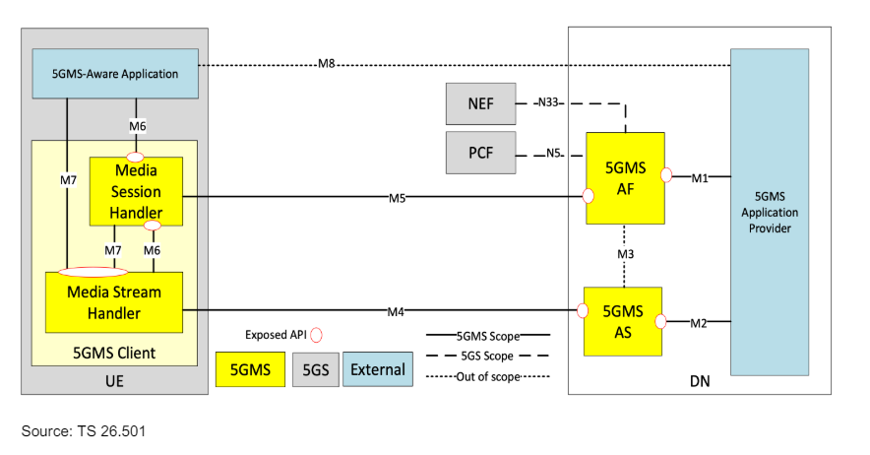
Problem Statement (recap)
5G Media Streaming
Architecture
Notes:
Mohamad

Slide 4



Problem Statement (recap)
The rapid evolution of 5G Media Technologies
Seamless implementation and interoperability
Difficulty in analyzing consumption patterns and handling reports
Notes:
Mohamad

Slide 5
Proposed Solution
Dashboard Interface
An easily accessible dashboard that visualizes QoE metrics and consumption reports
Actionable Insights
Provide users with insights into streaming performance through interactive charts
Data Sharing
Allow users to download and share the reports visualized by the dashboard with others
Notes:
Mohamad

Slide 6
Progress on Project Implementation
Deployed Next.js App at 5g-mag.vercel.app
We chose Next.js for its efficiency in handling fast implementations and deployment and the integration with React.js
Data Handling
We added the capability to read data from XML & JSON formats and display it graphically using Apex Charts
Initial Application Design
We added the initial dashboard design to ensure a responsive user interface as a basis for the charts that will be displayed with mock data for the now
Notes:
Dominik

Slide 7

Challenges/Blockers
We are pleased to report that we have not encountered any major challenges or blockers in our implementation process so far.
Notes:
Dominik

Slide 8
Short Live Demo
Notes:
Dominik

Slide 9
Project Schedule & Next Steps
We are using Github Projects linked to our project repository on Github to manage the tasks that we need to develop for the project implementation.
Project scheduling is done through Github Board for managing tasks (Kanban method) and the Roadmap view for setting milestones and for visualizations of the duration of the tasks we have created.
Notes:
Dominik

Slide 10
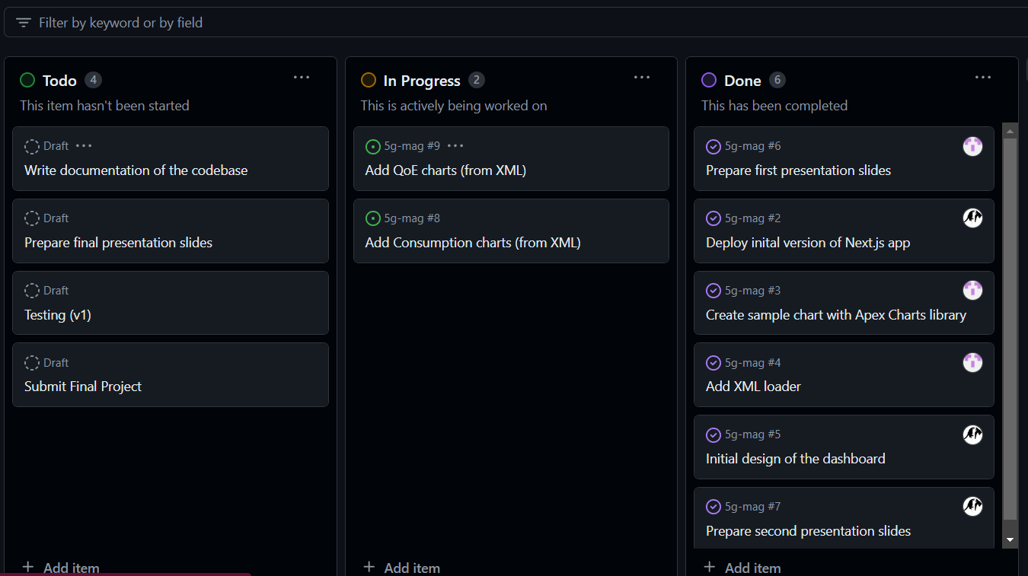
Project Schedule & Next Steps
Github Board
Notes:
Dominik

Slide 11
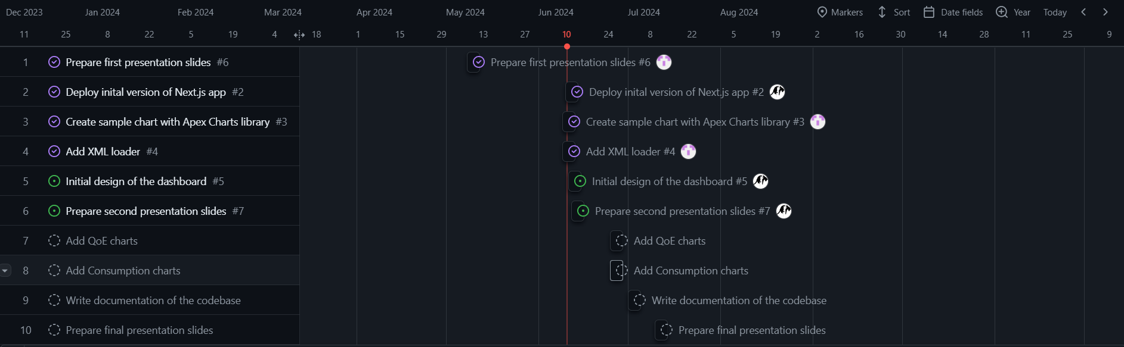
Project Schedule & Next Steps
Github Roadmap
Notes:
Dominik

Slide 12
Conclusions
Thank you for your attention!
Sara Pervana
MSc. Information Systems Management
sara.pervana@campus.tu-berlin.de
Mohamad Sakka Laeiq
MSc. Computer Science
m.sakkalaeiq@campus.tu-berlin.de
Notes:
Dominik

Slide 13
References
https://www.5g-mag.com/reference-tools
I. Ahmad, F. Osasona, S. Dawodu, O. Obi, A. Anyanwu, and S. Onwusinkwue, "Emerging 5G technology: A review of its far-reaching implications for communication and security," World Journal of Advanced Research and Reviews, vol. 21, pp. 2474-2486, Jan. 2024, doi: 10.30574/wjarr.2024.21.1.0346
Notes:
Dominik

